Slide 1
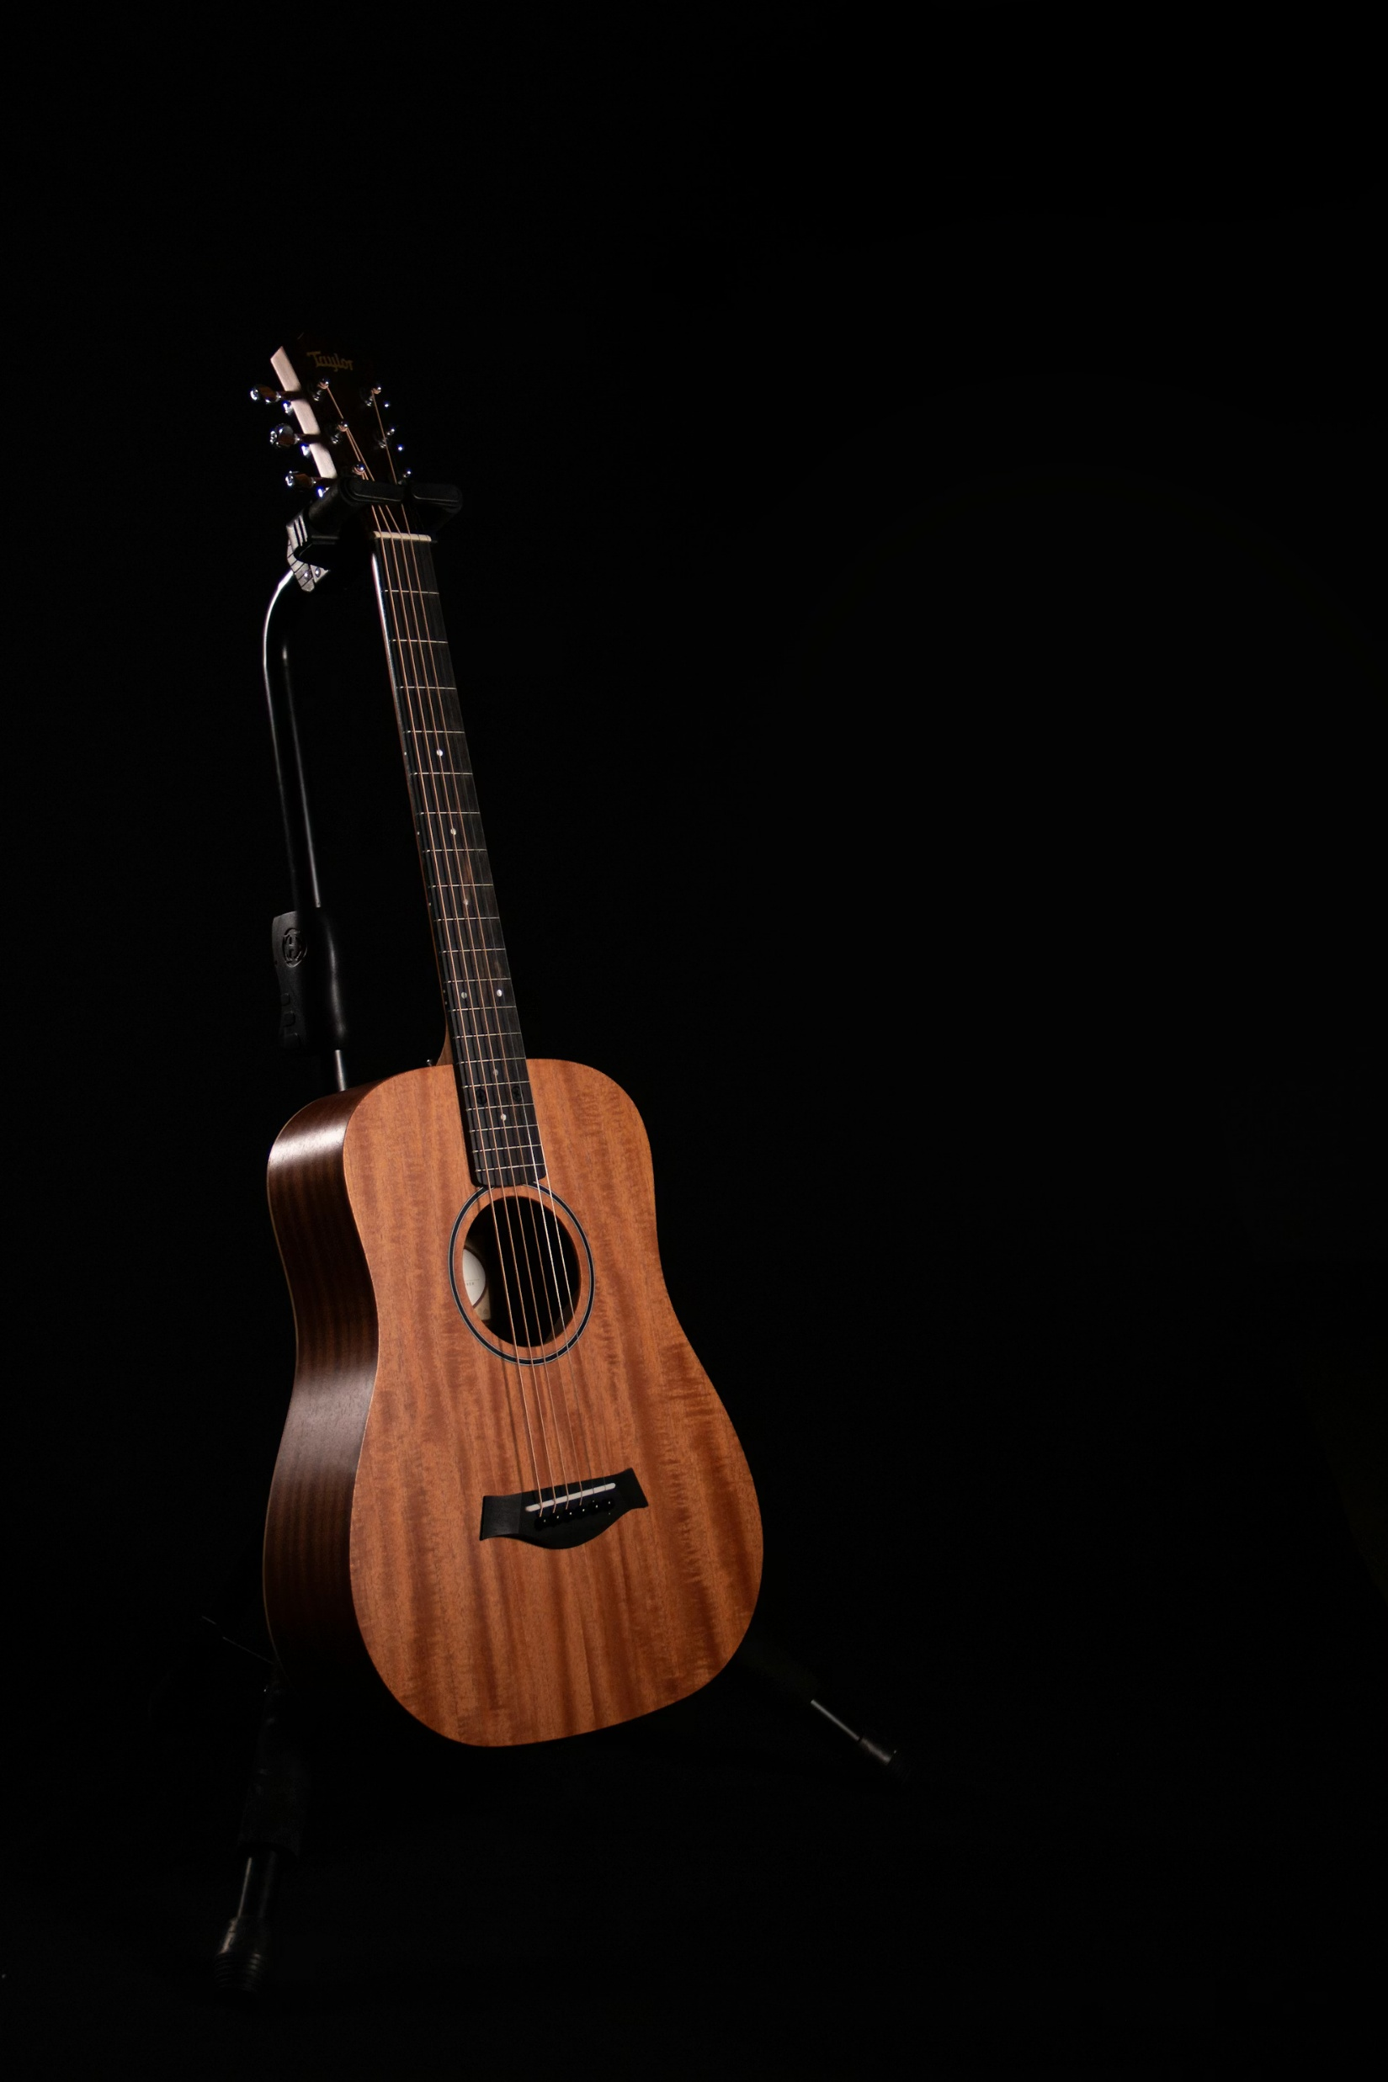
Musical Instruments Classification
ALI KHALED 22P0260
AHMAD SHERIF 2201075

Slide 2
Project Description
Image-Based classification of musical instruments
30 different instruments (30 classes)
Classical ML and deep learning models implemented

Slide 3

Dataset Overview
Dataset imported from Kaggle link: kaggle.com/musical-instruments-image-classification
No of Classes: 30
No of Images Loaded: 5093
80 / 20 Train Test Split

Slide 4
Methodology Roadmap
Phase 1: Baseline:
Classical ML approach using HOG descriptors with SVM and Random Forest.
Phase 2-3: Custom CNN: Building a Convolutional Neural Network from scratch with regularization.
Phase 4-6: Transfer Learning:
Leveraging MobileNetV2 and EfficientNetB0 for superior accuracy

Slide 5
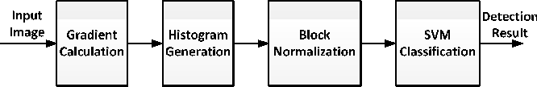
Preprocessing Pipeline
Resize images to 128x128
Convert to greyscale
Extract HOG features

Slide 6
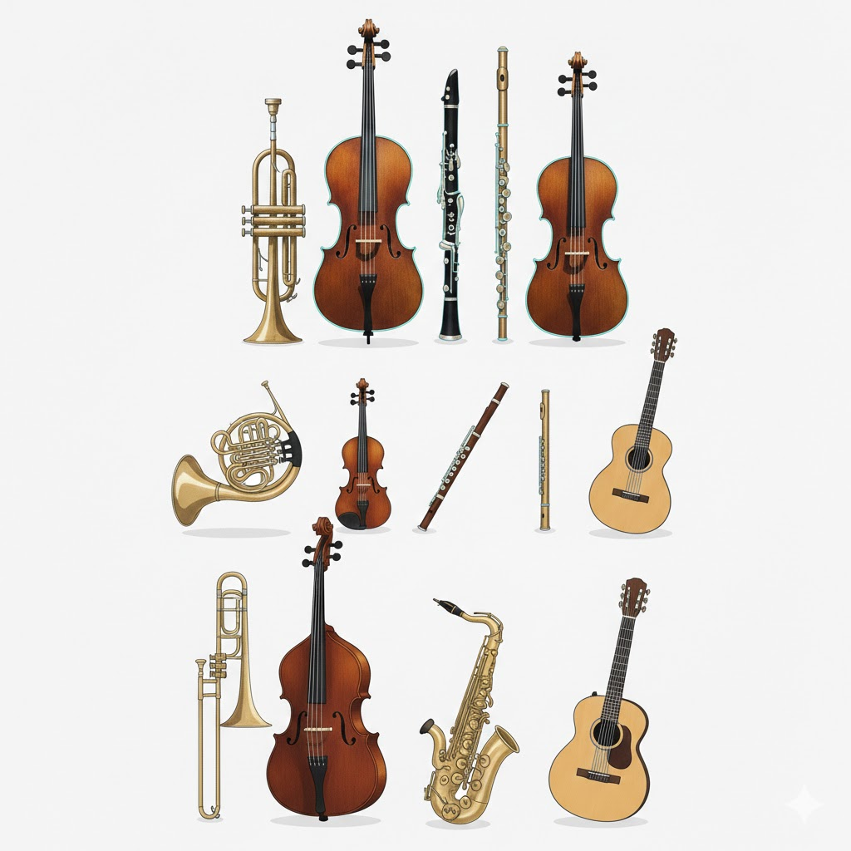
Feature Extraction
Extracted from grayscale images
Focuses on shape
The features extracted capture: Edge direction & strength Object contours & outlines Local shape patterns Texture-Like gradient structure

Slide 7
ML Classifiers Overview
Random Forest
Extra Trees
SVM
KNN
XGBoost

Slide 8
Random Forest
Ensemble of multiple decision trees
Each tree trained on random subsets of data and features
Final prediction by majority voting
Reduces overfitting compared to a single tree
Result:
Accuracy ≈ 47.5%

Slide 9
Extra Trees
Similar to Random Forest but with more randomness
Splits are chosen randomly instead of optimally
Faster training and stronger regularization
Reduces variance but may increase bias
Result:
Accuracy ≈ 50.2%

Slide 10
K-Nearest Neighbors (KNN)
Instance-based (lazy) learning algorithm
Classifies a sample using the majority vote of nearest neighbors
Distance metric: Euclidean distance
Sensitive to feature scaling and noise
Result:
Accuracy ≈ 49.9%

Slide 11
Support Vector Machine (SVM)
Finds an optimal hyperplane that separates classes
Maximizes margin between class boundaries
Uses kernel trick for non-linear separation
Effective in high-dimensional feature spaces
Result:
Accuracy ≈ 55.3%

Slide 12
XGBoost
Gradient boosting ensemble of decision trees
Trees are trained sequentially to correct previous errors
Uses regularization to prevent overfitting
Highly efficient and scalable
Result:
Accuracy ≈ 55.05

Slide 13
Phase 2 :
Custom CNN Architecture
Representation Learning
Designed a multi-layer CNN to learn hierarchical features directly from raw pixels
Conv2D Blocks: 32, 64, and 128 filters to capture spatial hierarchies.
.
Regularization: Dropout (0.5) to prevent overfitting on the training set.
Augmentation: Rotation, zoom, and flip to artificially expand the dataset.

Slide 14
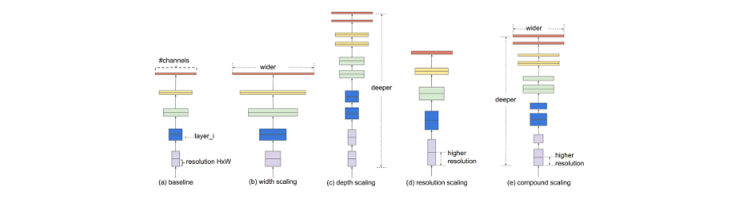
Phase 3: EfficientNetB0
Compound Scaling Success:
EfficientNetB0 uses a principled method to scale depth, width, and resolution simultaneously. It achieved our project's peak performance with high efficiency.
99.1%
FINAL ACCURACY

Slide 15
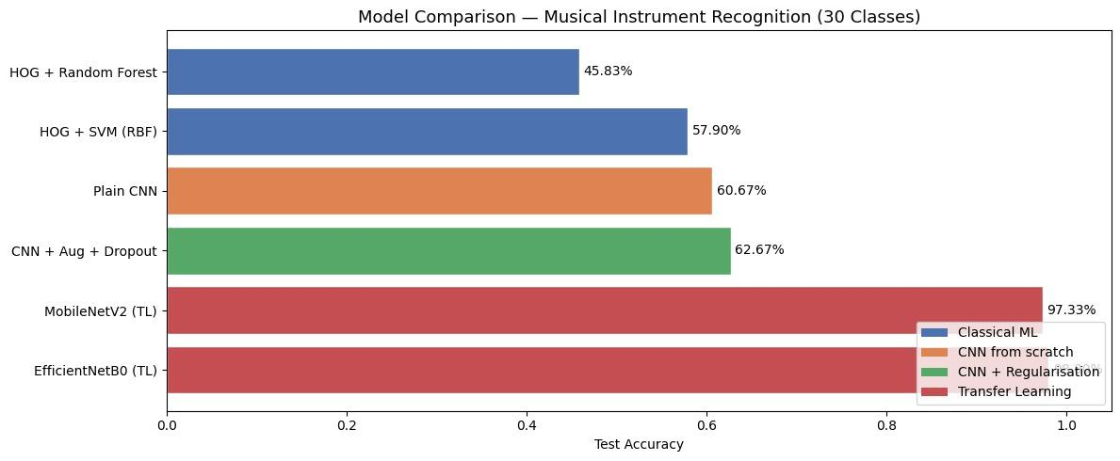
Comparative Analysis

Slide 16
Conclusion
Massive Accuracy Leap: Deep Learning (99.1%) vastly outperformed classical ML baselines (65.4%).
Better Feature Extraction: Automated CNNs captured complex details much better than manual HOG methods.
Transfer Learning Success: Pre-trained models like EfficientNetB0 maximized both training speed and final accuracy.
Future Focus: Resolving minor edge cases between visually identical instruments (e.g., Violin vs. Cello).

